Slide 1

BIO 228
I am honored to be working with some of the most amazing, strong, powerful, intelligent young people I have ever met.

Slide 2
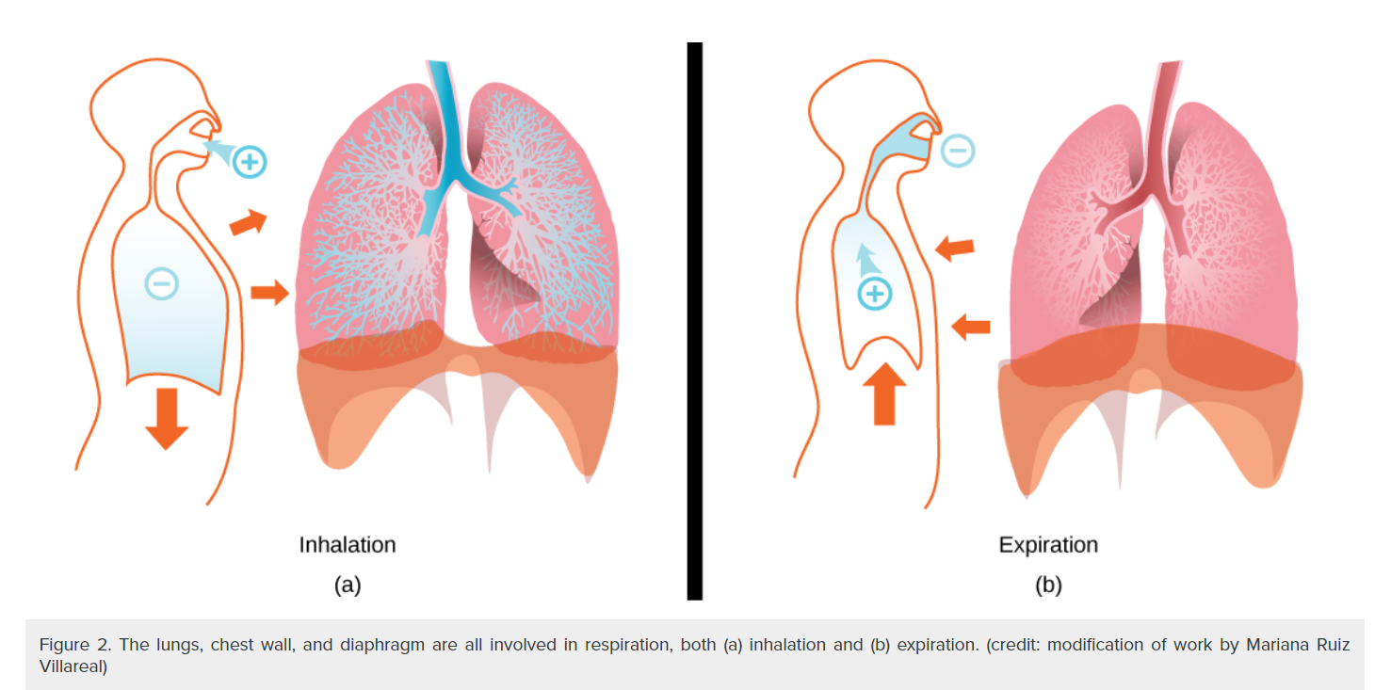
Negative breathing

Slide 3
More jokes…keep ‘em coming!
Joke: Why is the nervous system reckless? It does everything on impulse!
A patient told me a joke recently and it stuck with me. “What’s the longest word in the dictionary?
“Smiles” because there is a mile between first and last letters.

Slide 4
Set up for success: CONNECT Review!
Week 8: March 4 | Respiratory Read Ch 23 and watch lots of videos | RRM 23 *Work on Vaccine paper! Future: group review | Sunday, March 10
 |  | LAB: CONNECT Lab and Quiz
Vaccine paper due Mar.24, Test #2 also in Week 10
DATES Lecture And Lab ZOOM sessions (1-2 pm) | Read and Watch Chapter | Assignments, including Lab | Due date
Week 9:Monday, March 11 | Urinary Read Ch 24 And watch videos | RRM 24 Case: Collapsed pitcher Partner Review ONLY. Take notes for Individual, Final Review | Sunday, March 17
 |  | LAB CONNECT

Slide 5
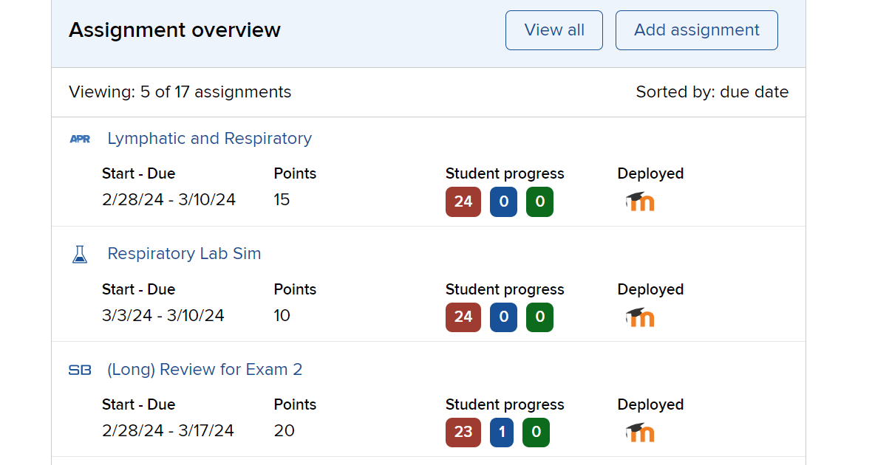
Review, Review, Review: (individual first) but handing in the GROUP review only

Slide 6
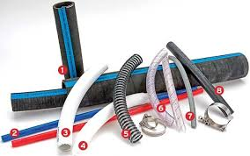

NEW 20.2. Blood Flow, BP and Resistance GREAT JOB ON THIS!

Slide 7

20.2 Vessels and Resistance: THINK-What can slow down blood flow? (mathematic, or practical)
Note: Veins are called “capacitance” vessels. They have thinner walls, can stretch easily and therefore can hold a lot-capacity.
Increase Pressure Flow
Volume Increase Increase
Resistance/Viscosity Increase Decrease
Length Decrease Decrease
Diameter________Decrease_____________Increase
*remember that contraction decreases dia. & relaxation increases it.

Slide 8
Review
1. What do we call the vessel that carries blood to the lungs?
2. What is the vessel that draws blood from the kidney and back to the heart?
3. What is the vessel that is found in the arm? You likely use it to take BP.
4. What vessel runs medial in the upper arm?

Slide 9


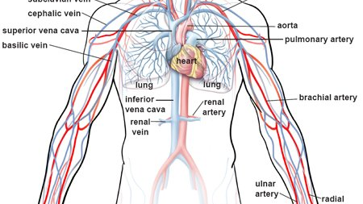

Slide 10
Review
What are the vessels in the hip region?
2. vessels to the thumb?
3. Vessels to the ulnar region?
4. Where are the jugular veins?

Slide 11
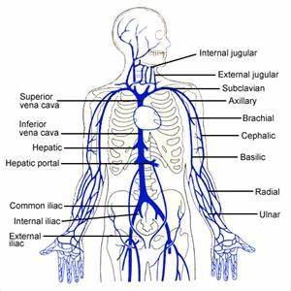

Slide 12
Review
1. What is the gonadal artery?
2. What does phrenic go to?
3. What do the mesenteric vessels surround?

Slide 13
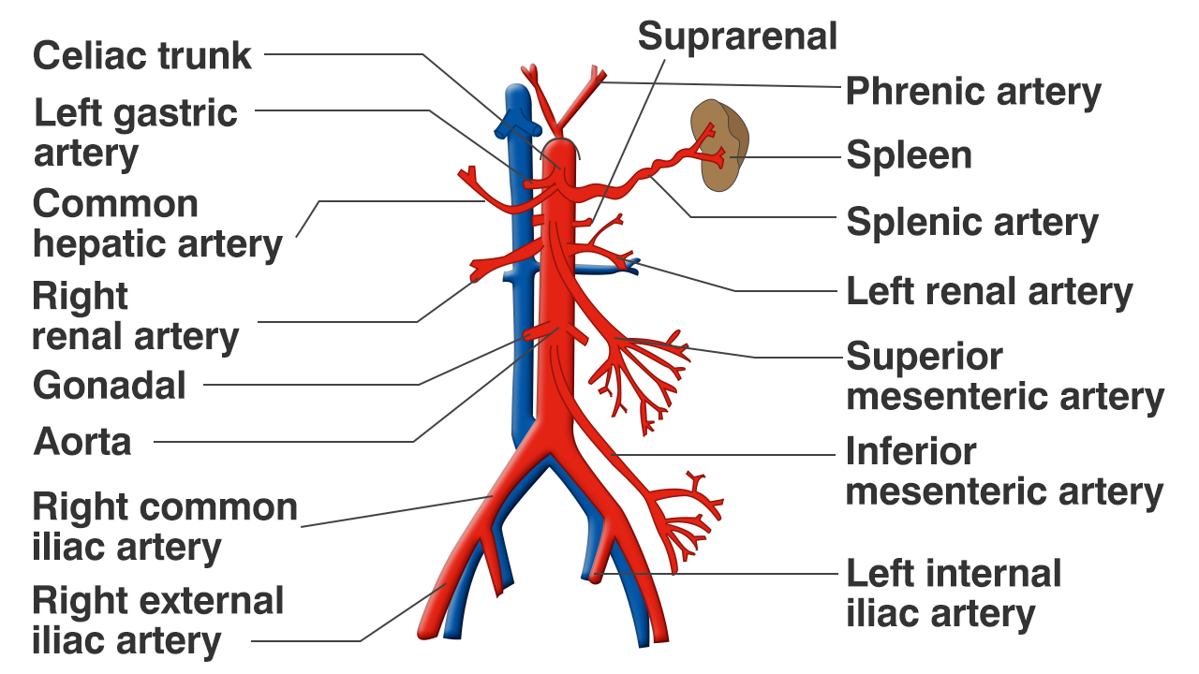

Slide 14
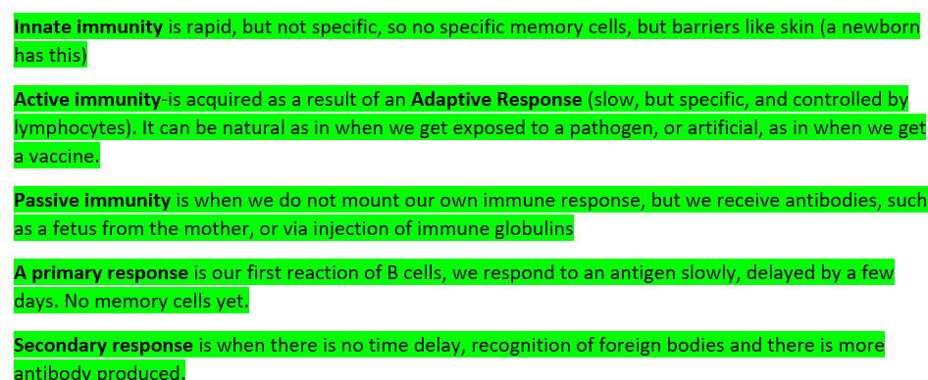
Immunity defined

Slide 15
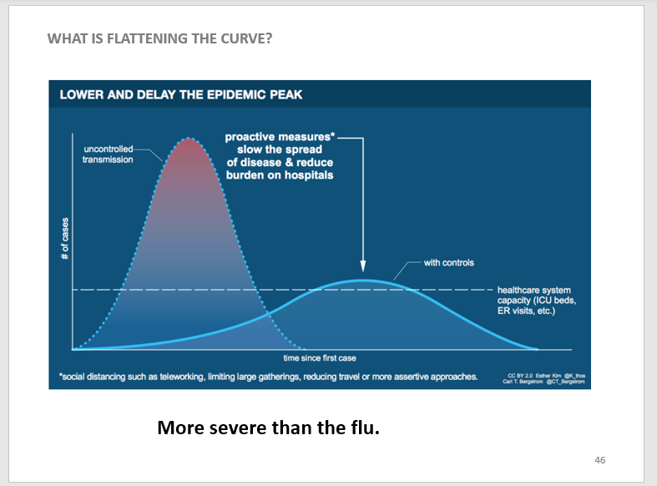
Flattening the curve

Slide 16
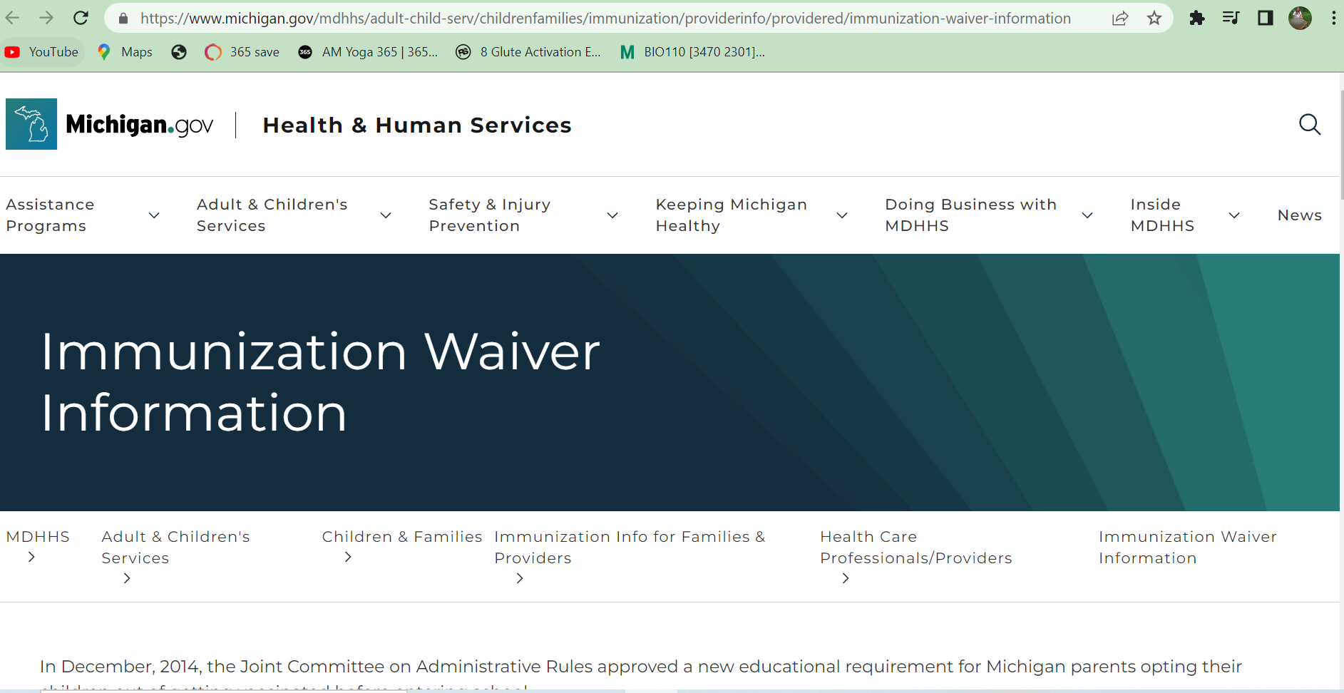
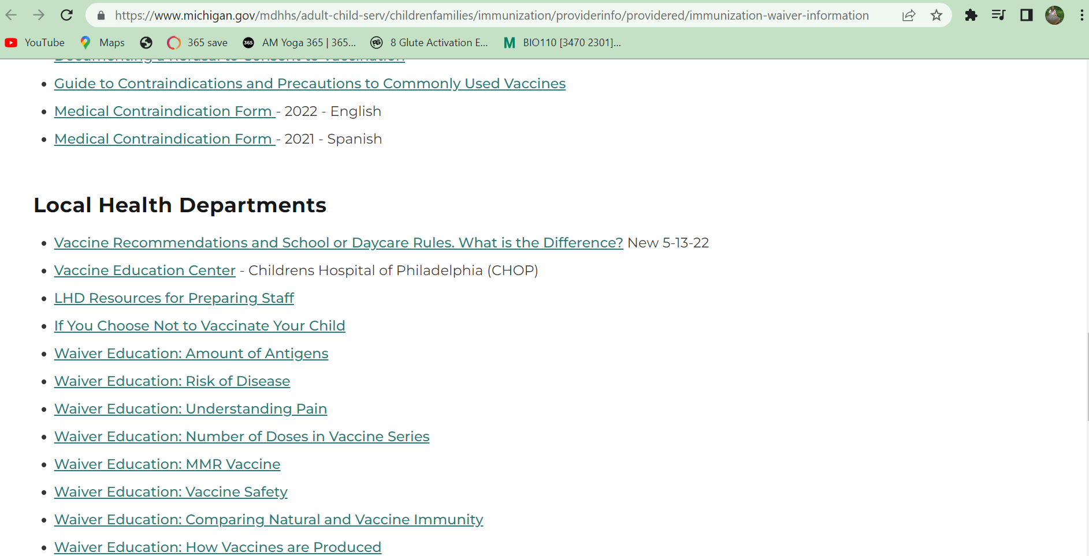
MI is a waiver state; www.Michigan.gov

Slide 17
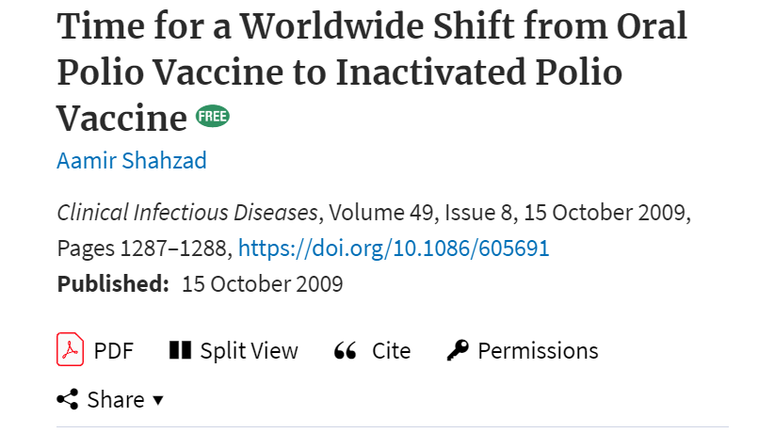
Looking for scientific journal articles?

Slide 18
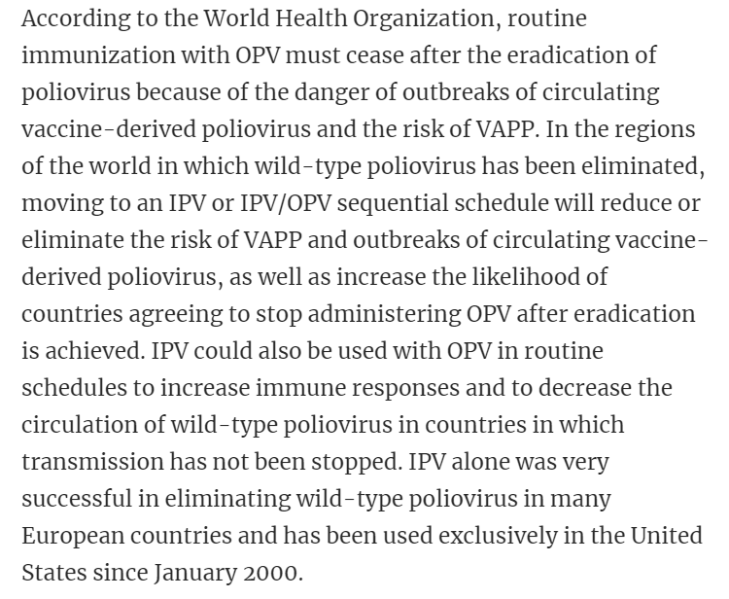
Polio and vaccines; VAPP is Vaccine-associated paralytic polio

Slide 19
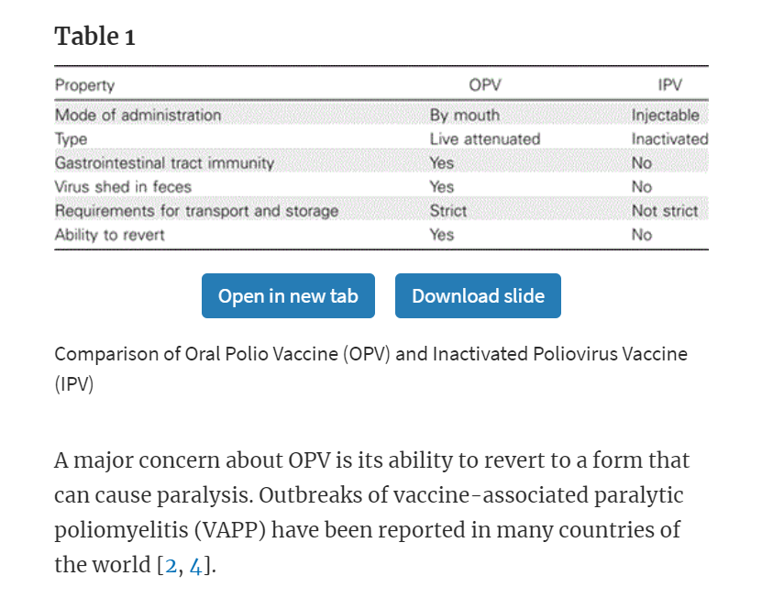
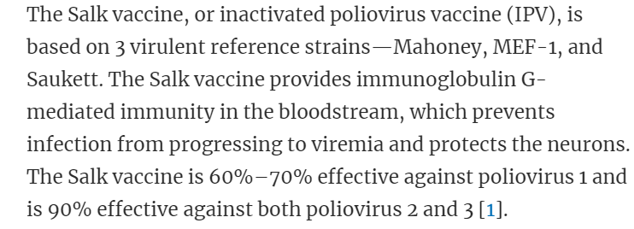
Polio Vaccines

Slide 20
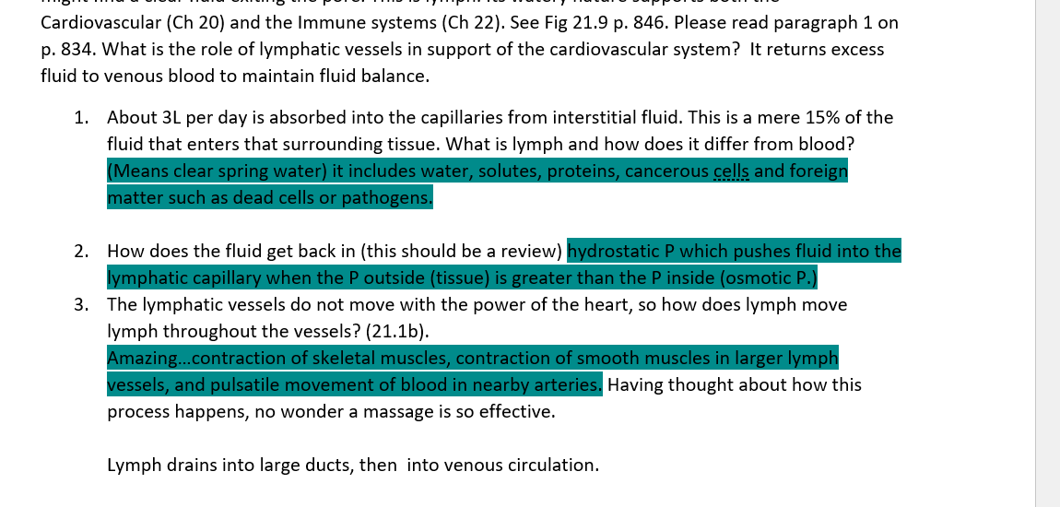
RRM Lymph and Immune
22.2c Contrast Innate and Adaptive: Innate is quick and general while adaptive is fast and specific.
22.3 f Fever is a symptom of either.

Slide 21
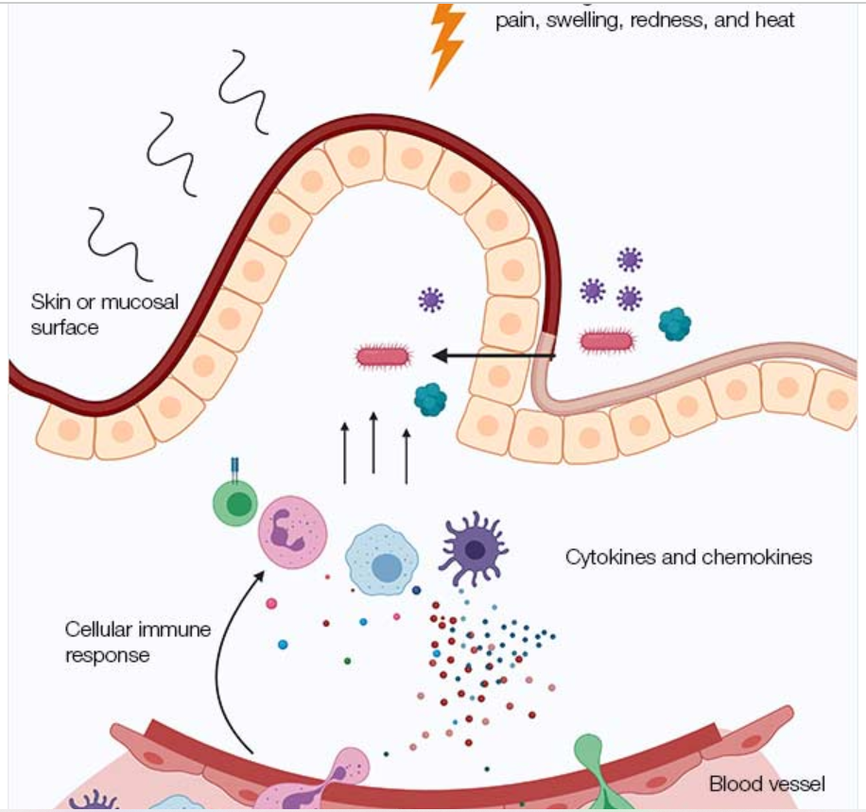
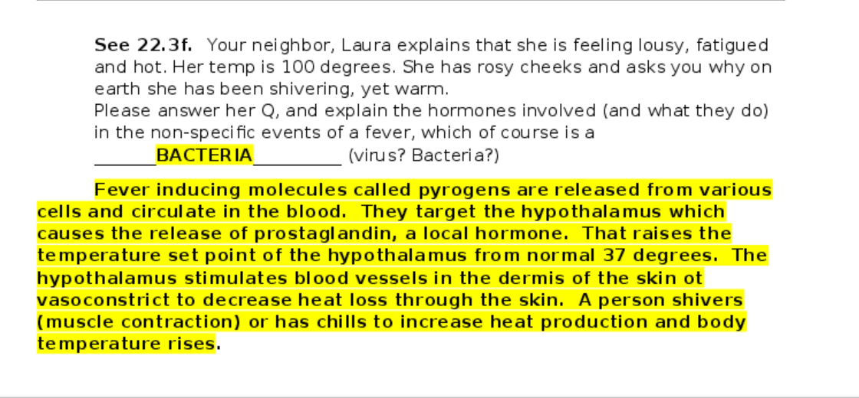
Fever and inflammation: Could be viral or bacterial

Slide 22
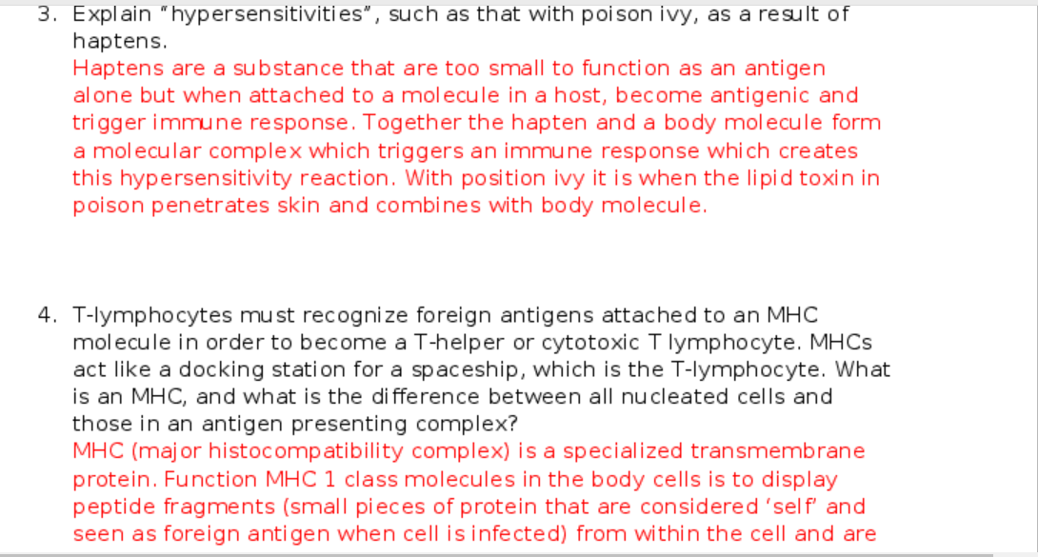
A good answer re: hypersensitivities

Slide 23
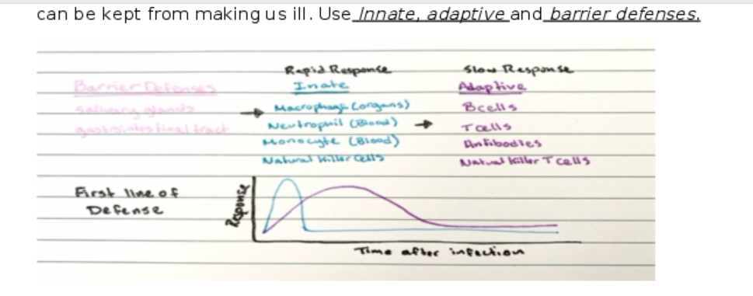

Slide 24
Terminology:
Epitopes are markers on the outside of the antigen (antibody attaches here) Opsonization is bonding of antibody to an epitope on a pathogen
Act 3: ELISA: The main ideas here are that antibodies are sought b/c by being present, we assume the antigen it is specific to is also present.
“False positive” means there are proteins that trigger a positive response, but not the expected or sought protein. Hence “washing”
Seroconversion is change from neg to pos. as a result of antibodies becoming present in the blood (vaccination, etc.). This takes time.
Its all about protein shape and its specificity (Q #1)

Slide 25
Chapter 23: Respiration What you already know: diffusion, osmosis, capillary function, pulmonary and heart relationship Lets go through the RRM

Slide 26
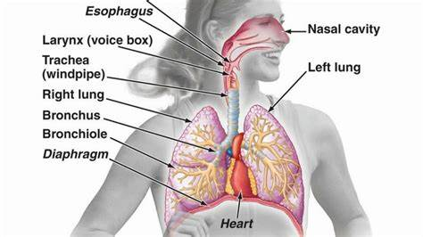

Slide 27
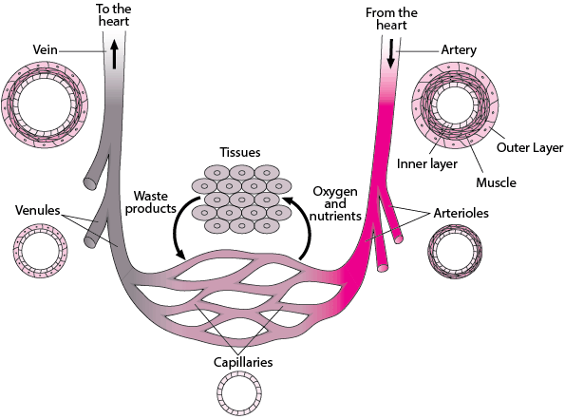
Review 20.1
NOTE how Arteries-Arterioles (See lumen layers, which are called “tunics”.)
What connects them?
Capillaries are only one layer thick and one cell wide.
Venules-Veins

Slide 28
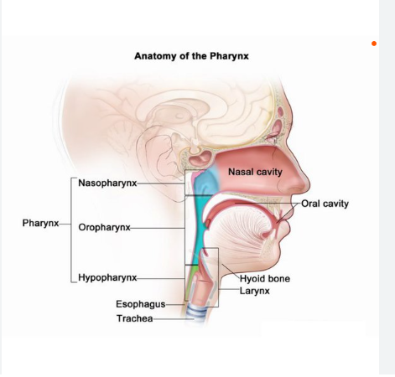
Pharynx vs Larynx
The pharynx is the tube that connects the mouth and nasal passages with the trachea (the windpipe) and with the esophagus (the tube to the stomach). The larynx (also called the voice box) is the upper part of the trachea that contains the vocal cords. The larynx is located right below the pharynx.

Slide 29
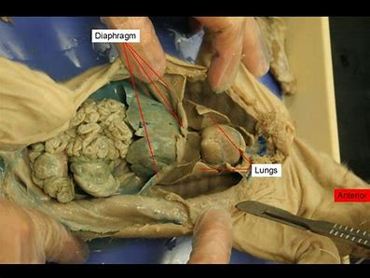
Q2. breathing (uses diffusion): try it with me!

Slide 30
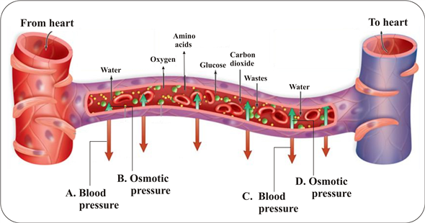
Q 6 Capillary Exchange: Filtration (OUT), RE-absorption (IN)
Movement in and out of capillaries is run by Hydrostatic P (P. of fluid in a space) and Osmotic P (you know this!)
Arterial end: Filtration Venule end-Reabsorption

Slide 31
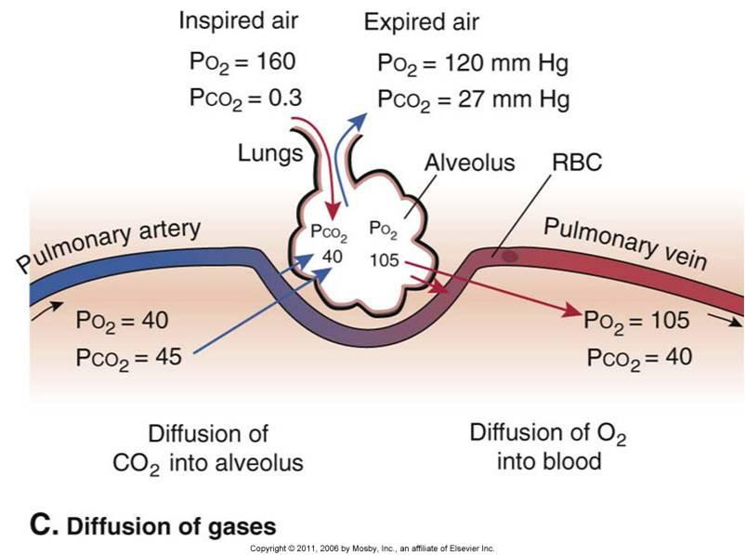
COVID for example
Q 6

Slide 32
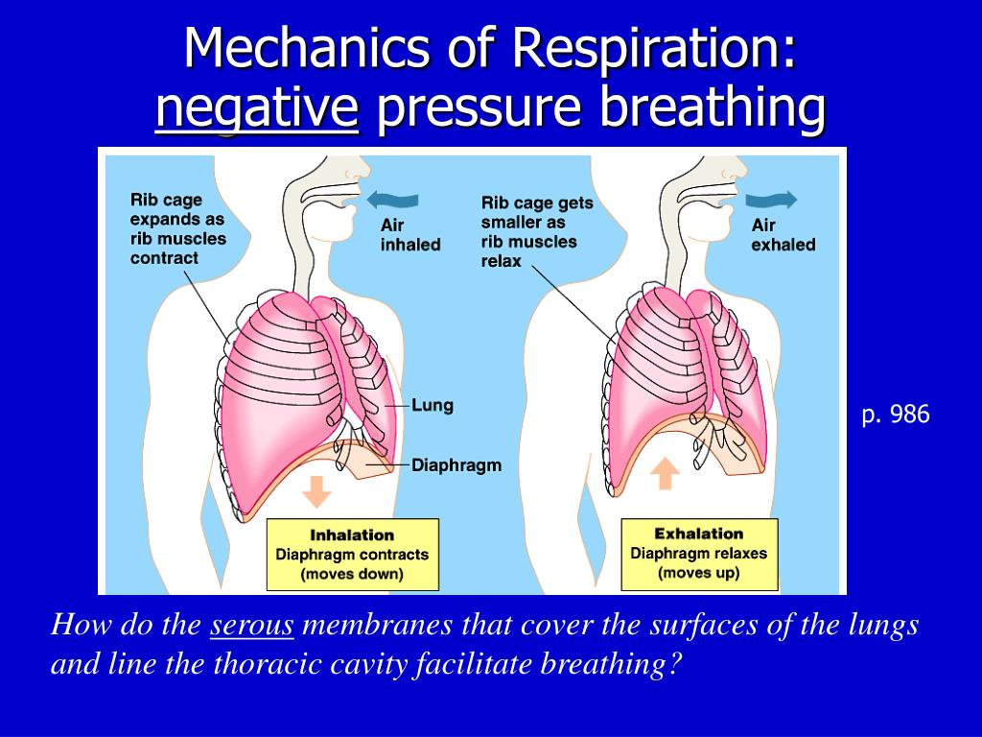
Q 8. Negative P. breathing
Lungs regulated by volume and pressure
Stickiness to ribs (pericardium)
Intercostals and diaphragm

Slide 33
Q 9. Nasal breathing no “mouth breathers allowed!” (this is sleep apnea)
Research spanning 70 years focusing on heart concluded that “the greatest indicator of life span wasn’t genetics, diet, or the amount of daily exercise”, but lung capacity. “The smaller and less efficient lungs became”, regardless of the reason, “the quicker subjects got sick and died.”
Chewing (gnawing), humming, extending the diaphragm and nasal breathing
Nasal breathing filters air, slows the pace (regulates CO2). Mouth breathing collapses the soft tissue at back of throat.
Your nose will perform as it is needed. When stuffed up, try breathing through nose. (See research study-sesame oil!)

Slide 34
Q 9. Take note:
Homeostasis: our body determines our breathing rate by amt. of CO2
When we breathe too much, We expel too much CO2 and our blood becomes acidic. Our body seeks 7.4 pH, for optimal performance
Stress leaves us with shallow breaths while most of the PSNS nwerves are located in the lower lobes of lungs (vagus baby!)
By pausing in between breaths (fully breathing out before breathing in) we decrease SNS and increase PSNS

Slide 35
TRY IT! Q 9. The best breath
Using your nose
Inflating your diaphragm all the way around your body, Not elevating shoulders
5.5 seconds in, 5.5 seconds out (nose in and pursed lips out) gives 5.5 breaths/min

Slide 36
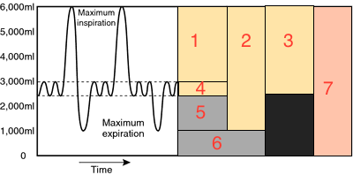
Q. 10 Activity 1 (Rev Q. 1-5)
Ventilation = Phase Inhalation + Phase Expiration
and uses the diaphragm and intercostal muscles.
This process relies on pressure in the atmosphere (760 mmHg) and also in your lungs.
Atmospheric air is largely made up of N2 (~78%), O2 (~21%), H2O (~.4%), and CO2 (~.04%).
Therefore O2 (as it is a part of the overall) has “partial pressure” of .21 X 760 mmHg=160 mmHg.

Slide 37
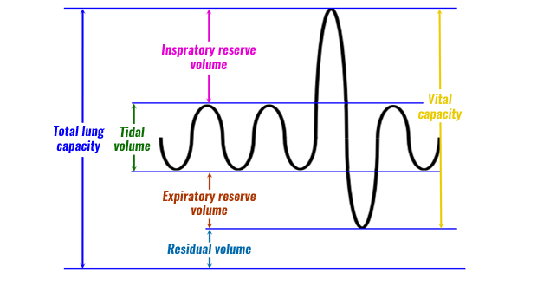
Terms and image: TRY IT
Q. 10. Respiratory Volume (RV)
Atmospheric air is largely made up of N2 (~78%), O2 (~21%), H2O (~.4%), and CO2 (~.04%).
Therefore O2 (as it is a part of the overall) has “partial pressure” of .21 X 760 mmHg=160 mmHg.
Tidal Volume (TV)
Like a soft tide
Inspiratory Reserve Volume (IRV)
Expiratory Reserve Volume (ERV)
Both are beyond tidal volume as in exercise
Residual Volume (so lung doesn’t collapse!=RV)
TLC=RV+TV+IRV+ERV

Slide 38

Q 12. Nose breathing and CO2

Slide 39
Q. 12 stantly Improve Your Sleep & Health | James Nestor
https://video.search.yahoo.com/search/video?fr=mcafee&ei=UTF-8&p=james+nestor+5.5+breath&type=E211US714G0#id=4&vid=b636859dfe78c51eb6b11a2dfa4a122b&action=view

Slide 40
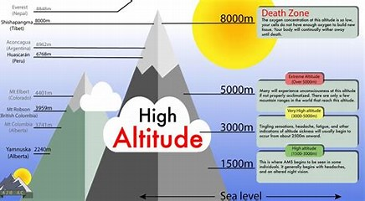
Q 12.

Slide 41
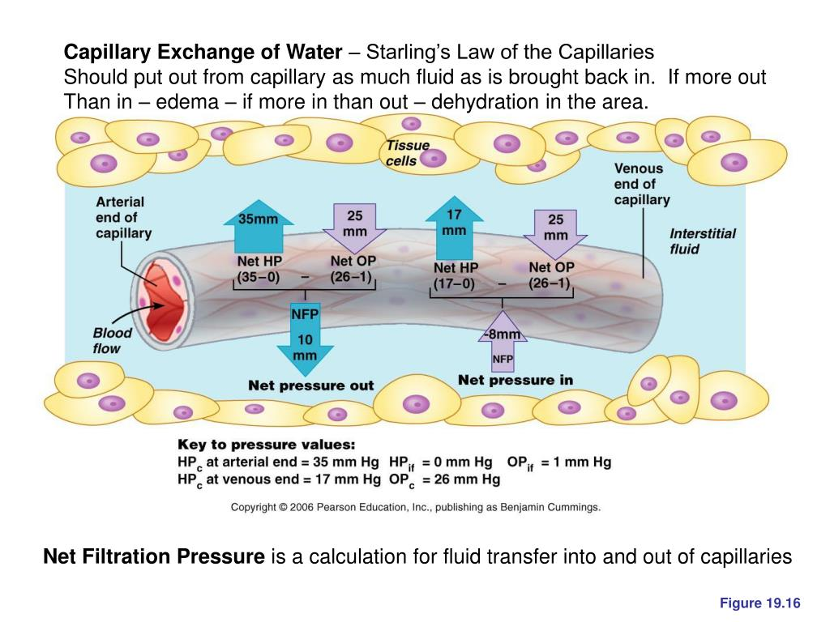
Q 13.

Slide 42
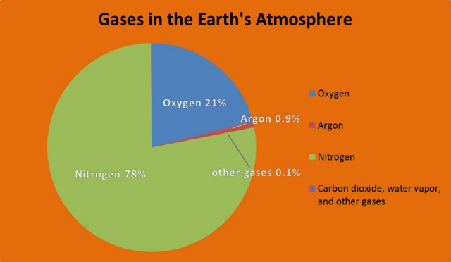
Q 12 Atmosphere: O2? CO2?

Slide 43
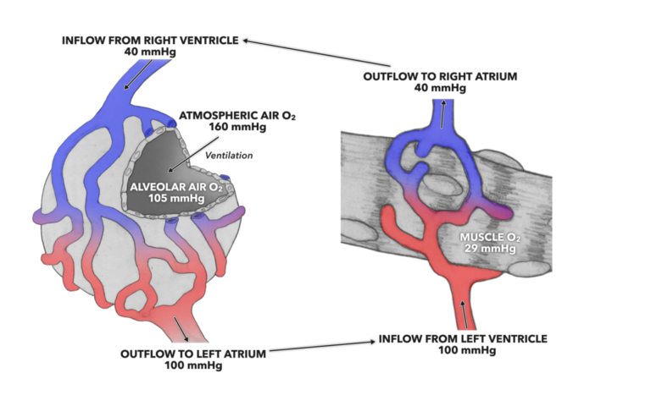
Q 13. Alveolar Flow

Slide 44
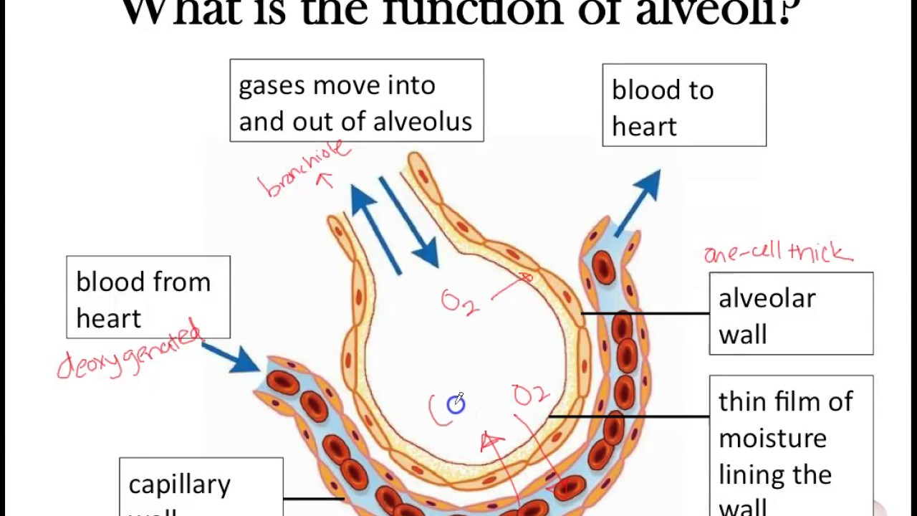
Function of Alveoli?

Slide 45
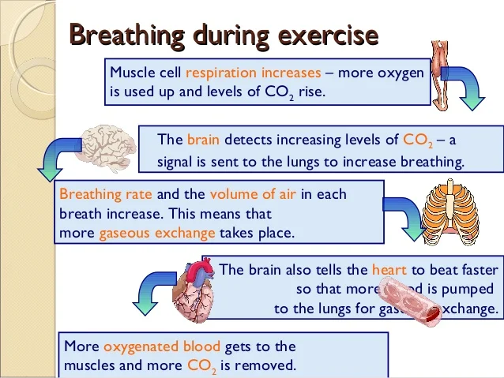
exercise

Slide 46
Using A Spirometer
Emphysema
Asthma w and w/o inhaler
Exercise:
Loss of elastic recoil, therefore there is high resistance due to integrity of the lung tissue.
As a result, exhaling is difficult (there is no passive recoil)
Bronchiole spasm and airways become constricted and clogged with mucus. Airways collapse and pinch closed
Inhaler smooth muscle relaxant and/or anti-inflammatory
MODERATE: Rate of breathing and tidal volume increase. TV is greater
Heavy: Rate of breathing and tidal volume increase at the same rate.

Slide 47
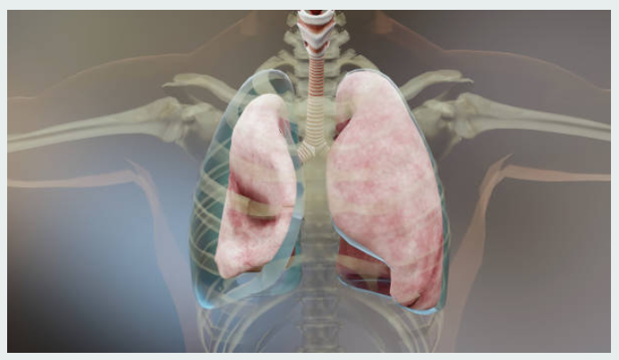
Medical issues:
Pneumothorax. If any openings exist, air moves in and the pressure gradient is equalized
Atelectasis can occur if Pneumothorax is left untreated. This is lung collapse.
Surfactant=This is like a detergent, made of lipids and proteins, so that water molecules are NOT attracted to each other on this pleural surface.
Intrapleural P is less than the P in the alveoli, and lungs move away from the thoracic wall creating a partial vacuum

Slide 48
Set up for success: CONNECT Review!
Week 8: March 4 | Respiratory Read Ch 23 and watch lots of videos | RRM 23 *Work on Vaccine paper! Future: group review | Sunday, March 10
 |  | LAB: CONNECT Lab and Quiz
Vaccine paper due Mar.24, Test #2 also in Week 10
DATES Lecture And Lab ZOOM sessions (1-2 pm) | Read and Watch Chapter | Assignments, including Lab | Due date
Week 9:Monday, March 11 | Urinary Read Ch 24 And watch videos | RRM 24 Case: Collapsed pitcher Partner Review ONLY. Take notes for Individual, Final Review | Sunday, March 17
 |  | LAB CONNECT

